Slide 1

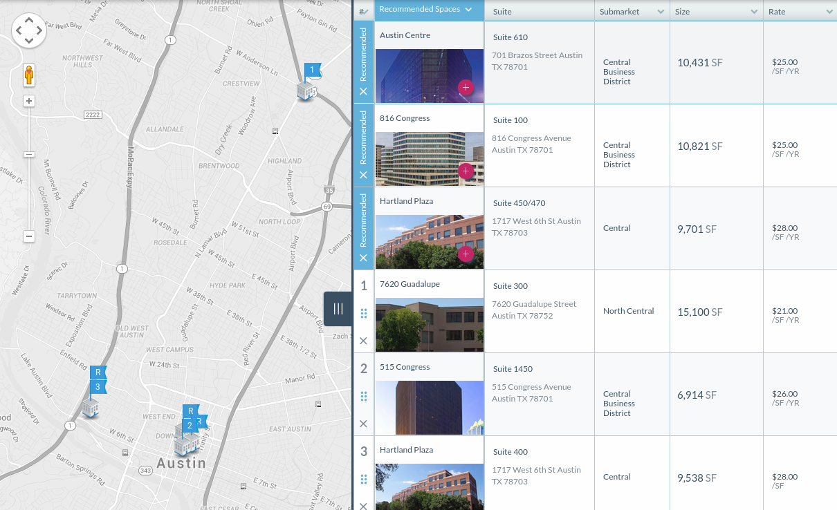
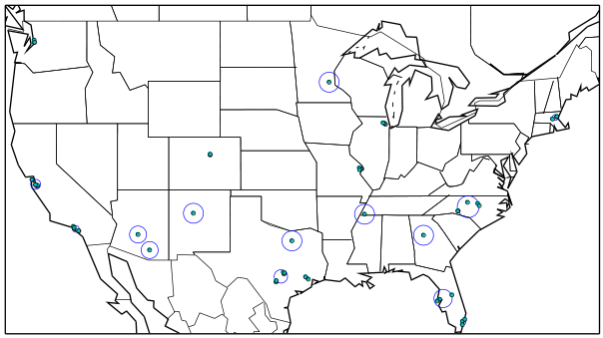
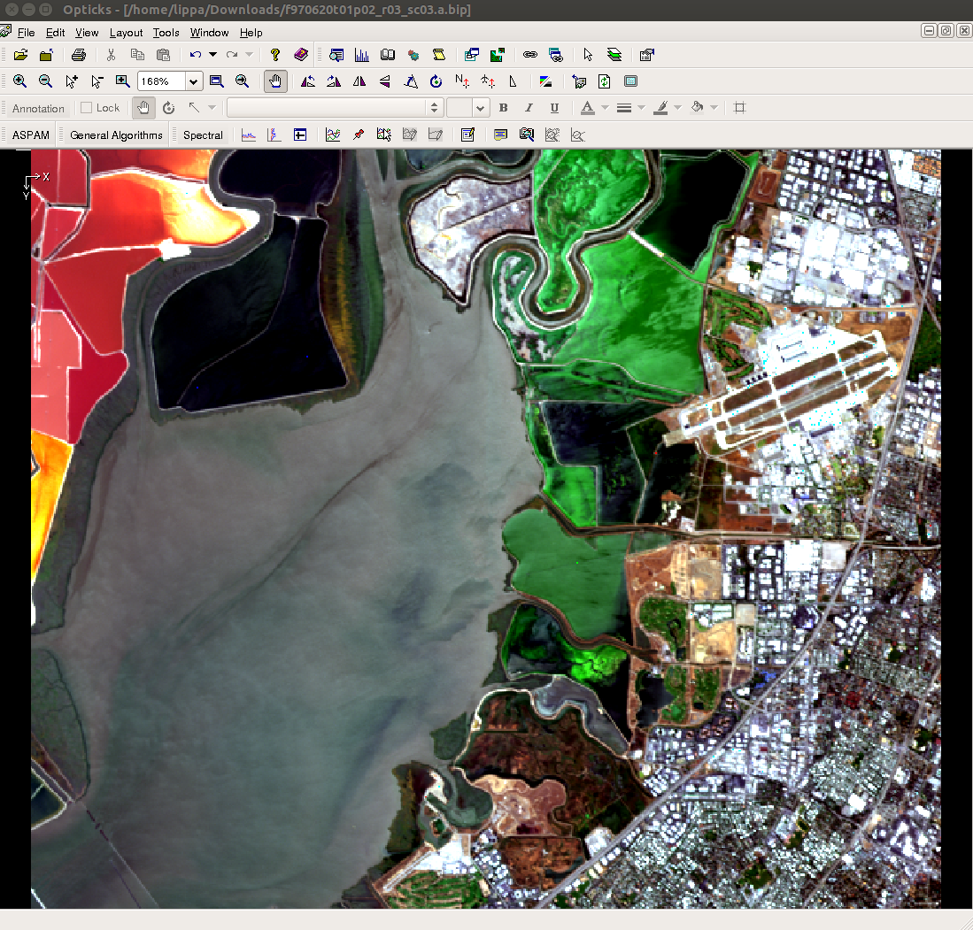
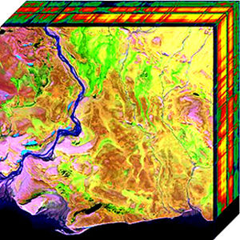
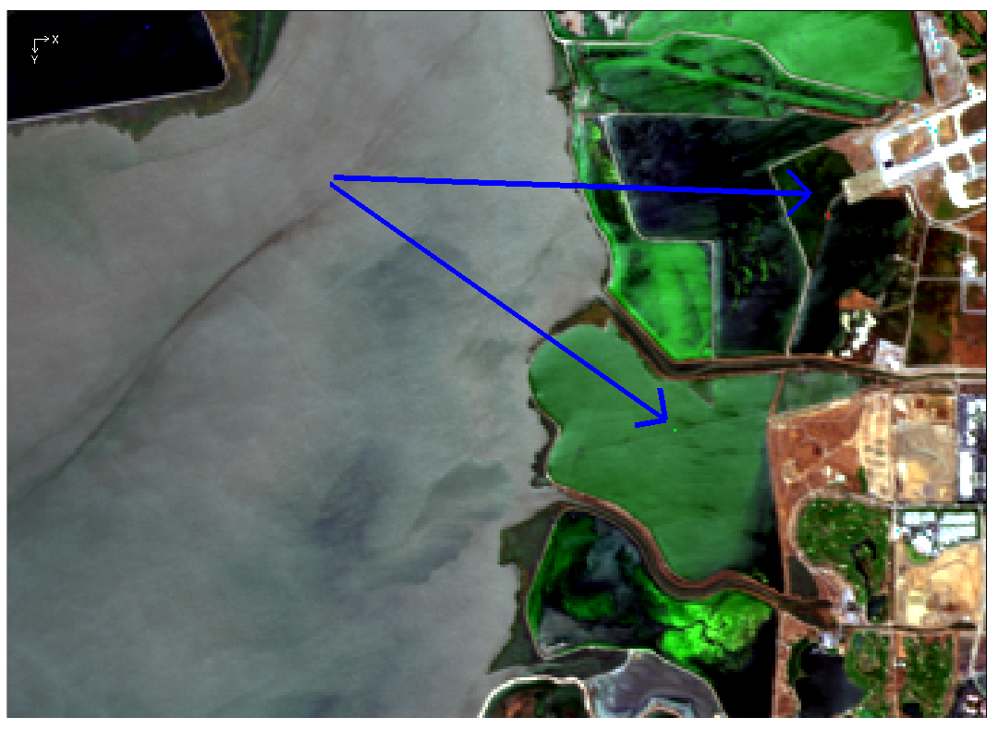
Creating a Real-Time Recommendation Engine using Modified K-Means Clustering and Remote Sensing Signature Matching Algorithms
David Lippa* Jason Vertrees*
Abstract
Built on Google App Engine, RealMassive encountered challenges while attempting to scale its recommendation engine to match a 14% week-over-week increase of data. To address this problem of scale, we applied techniques from spectral data processing to transform our domain-specific problem. The result: a quantitative solution to a qualitative problem that can be implemented on our platform and operates in sub-second time.
Method
There are 3 phases needed to overcome constraints imposed by App Engine²:
Cluster user inputs into “signatures” reduces the length of query strings and sort expressions.
Apply fixed filters to limit search results to within the 10,000 hit sort limit.
Score results by signature match to override the default search-term relevance score.
Step 2: Filtering
Next, we apply fixed filters informed by domain expertise. For commercial real estate, this includes the building type (such as "office", "industrial", etc.) and location, along with any necessary exclusions. These constraints produce a reasonably sized subset of no more than 10,000 results that can be matched against the signatures generated during the clustering phase.
Step 1: Clustering
K-means clustering is one of the best-known methods for breaking up n data points into k discrete clusters. While easy to implement and fast in practice, a few worst-case scenarios may arise in certain unusual data conditions⁸. To mitigate this, our algorithm takes advantage of a few known attributes of the data:
Limited overlap between data points since they exist physically in 3-dimensional space
Limited data range since the data is clustered by latitude and longitude
Additional data that can be used to improve estimation of the initial cluster sizes.
Step 3: Sort by Angle
Executing the SAM algorithm on a reduced dataset of 10,000 items is comparable to performing material identification on a 115 x 87 pixel data collection from a 3-band multi-spectral sensor. When contrasted against a small spectral dataset, such as Figure 4, this is a trivially fast operation.
Google App Engine’s search service provides a faster means of execution, in the form of a sort expression, but, lacks the inverse cosine function². Our solution used the cosine ratio as a proxy for the angle: sorting by the cosine ratio in descending order is functionally equivalent to sorting by the angle in ascending order to find the most similar match. Additional steps, such as applying a cosine rule or Euclidian distance calculation, would prevent extreme cases–such as the vectors (1, 1, 1) and (1000, 1000, 1000)–from consideration as a perfect match.
Figure 1: A Commercial Real Estate Survey with Recommendations
Background
Algorithms used in spectral analysis provide one way to quantify similarity, often used in the process of material identification³ ⁶ ⁹ using a known signature—quite literally, finding a needle in a pixelated haystack. Spectral Angle Mapper treats each pixel as a vector, compared against a signature by computing the angle between the two n-dimensional vectors using the definition of a dot product: A · B = ||A|| ||B|| cos θ. An angle of 0° indicates a collinear match.
Figure 3: Clustering 50 spaces from across the US
To remap the problem, we:
Treat the list of potential candidates as “pixels” of a spectral data cube
Convert the known and desirable user inputs into a library of “signature” vectors
    Only use independent object attributes for vector components. In Commercial Real Estate, some examples are cost, size, number of parking spaces, etc.
    Avoid ratios and dependent variables
Use a cosine ratio as a proxy for θ since the function cos⁻¹(x) is unavailable in Google App Engine Search²
This solution results in a quantifiable, accurate, and flexible measurement of similarity: an angle of 0 indicates collinear similarity.
The algorithm operates as follows:
Create a set S = { s1, s2, …, sn } representing each office space.
Create a kd-tree S using the set P
While S is not empty:
    Pop off point s from the set and compute the radius r around it containing the nearest 50 neighboring buildings using a pre-built SciPy KDTree. Use starting starting maximum distance d = 0.082° ≅ 9 km.
    Using K, find all nearest neighbors within r, adding them to a new cluster and removing them from P.
    Merge the new cluster into an existing cluster, if needed.
If the number of clusters is greater than k, recursively perform Step 3-4 with the original set P and 2d as the new maximum distance. Otherwise, merge intersecting clusters and compute a weighted centroid and radius for each cluster.
Doubling the initial radius results in an absolute maximum of 26 recursive calls for an asymptotic complexity of O(kn logk n). This never happens in practice, since we use the nearest 50 buildings, which have limited geographic density, to compute a starting radius. The final result is similar to the representation of clusters in Figure 3⁵. Once the spaces have been clustered, it is trivial to compute the average of each vector component to produce each cluster’s signature.
Figure 4: AVARIS data courtesy NASA/JPL-Caltech, with insert showing a signature match¹⁺
Summary
Google App Engine provides a scalable infrastructure with an advanced search engine that can be utilized for purposes beyond typical search use cases. We present a novel approach to recommendation systems by drawing parallels between domain-specific recommendation matching and material identification processes used in remote sensing. Though our specific problem is a case of pattern matching, the strategy of leveraging constraints and satisficing over optimizing helped us overcome rapid data growth and the seemingly restrictive toolbox provided by Google App Engine.
Figure 2: Graphic representation of hyper-spectral data⁷
The authors may be contacted at david.lippa@realmassive.com and jason.vertrees@realmassive.com
+ This data cube measures 614 x 512 pixels x 224 bands spanning the entire visible, near-infrared, and short-wave infrared spectrum. Visualizations provided by the open-source Opticks remote sensing toolkit^{[Opt15]}.
References:
1. AVARIS Home page. (2015, June 26). Retrieved from http://aviris.jpl.nasa.gov/data/free_data.html
2. Google. (2015, June 11). Google App Engine for Python 1.9.21 Documentation.
Retrieved from https://cloud.google.com/appengine/docs/python
3. Landgrebe, David A (2005). Signal Theory Methods in Multispectral Remote Sensing. Hoboken, NJ: John Wiley & Sons.
4. Opticks. (2015, June 26). Google App Engine for Python 1.9.21 Documentation. Retrieved from https://opticks.org
5. RealMassive. (2015, June 10). Retrieved from https://www.realmassive.com
6. M. Richmond. Licensed under Creative Commons. Retrieved from http://spiff.rit.edu/classes/phys301/lectures/comp/comp.html
7. N Short, Sr. Graphic representation of hyperspectral data. Licensed under Creative Commons.
Retrieved from http://rst.gsfc.nasa.gov/
8. A. Vattani. K-means Requires Exponentially Many Iterations Even in the Plane, Discrete Comput Geom. 45(4): 596–616. 2011.
9. H. Zhang, Y. Lan, R. Lacey, W. Hoffmann, Y. Huang. Analysis of vegetation indices derived from aerial multispectral and ground hyperspectral data, International Journal of Agricultural and Biological Engineering. 2(3): 33. 2009.
Acknowledgments
The authors would like to thank Fatih Akici and Michael Westgate for their suggestions for this poster.

